Slide 1
Breaking Barriers: Empowering Girls through Coding*
Erin M. Buchanan, ph.D.
*Title suggested by ChatGPT

Slide 2
Outline
Who am I?
What do I do?
What is a language model anyway?
Uses of language models
Problems with language models
Questions?

Slide 3
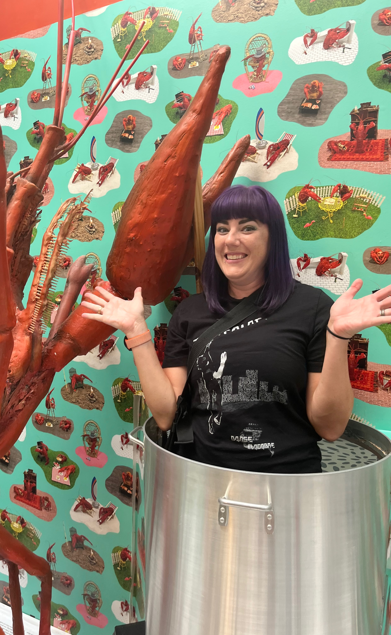
I am…
From the Texas-Louisiana border
A big fan of college football and baseball
Usually going hiking or to a concert
A math-nerd who never grew up

Slide 4
Professionally
I went to Texas A&M for my undergraduate degree.
Then to Texas Tech for my graduate degree.
My degrees are in …
PSYCHOLOGY!

Slide 6
PSYCHOLOGY?!
What does psychology have to do with code or STEM careers?
Social science is hard!
What I do:
Professor teaching statistics and natural language processing
Write statistics and science software
Run research projects using coding to create models and answer questions
Run a YouTube channel!

Slide 7
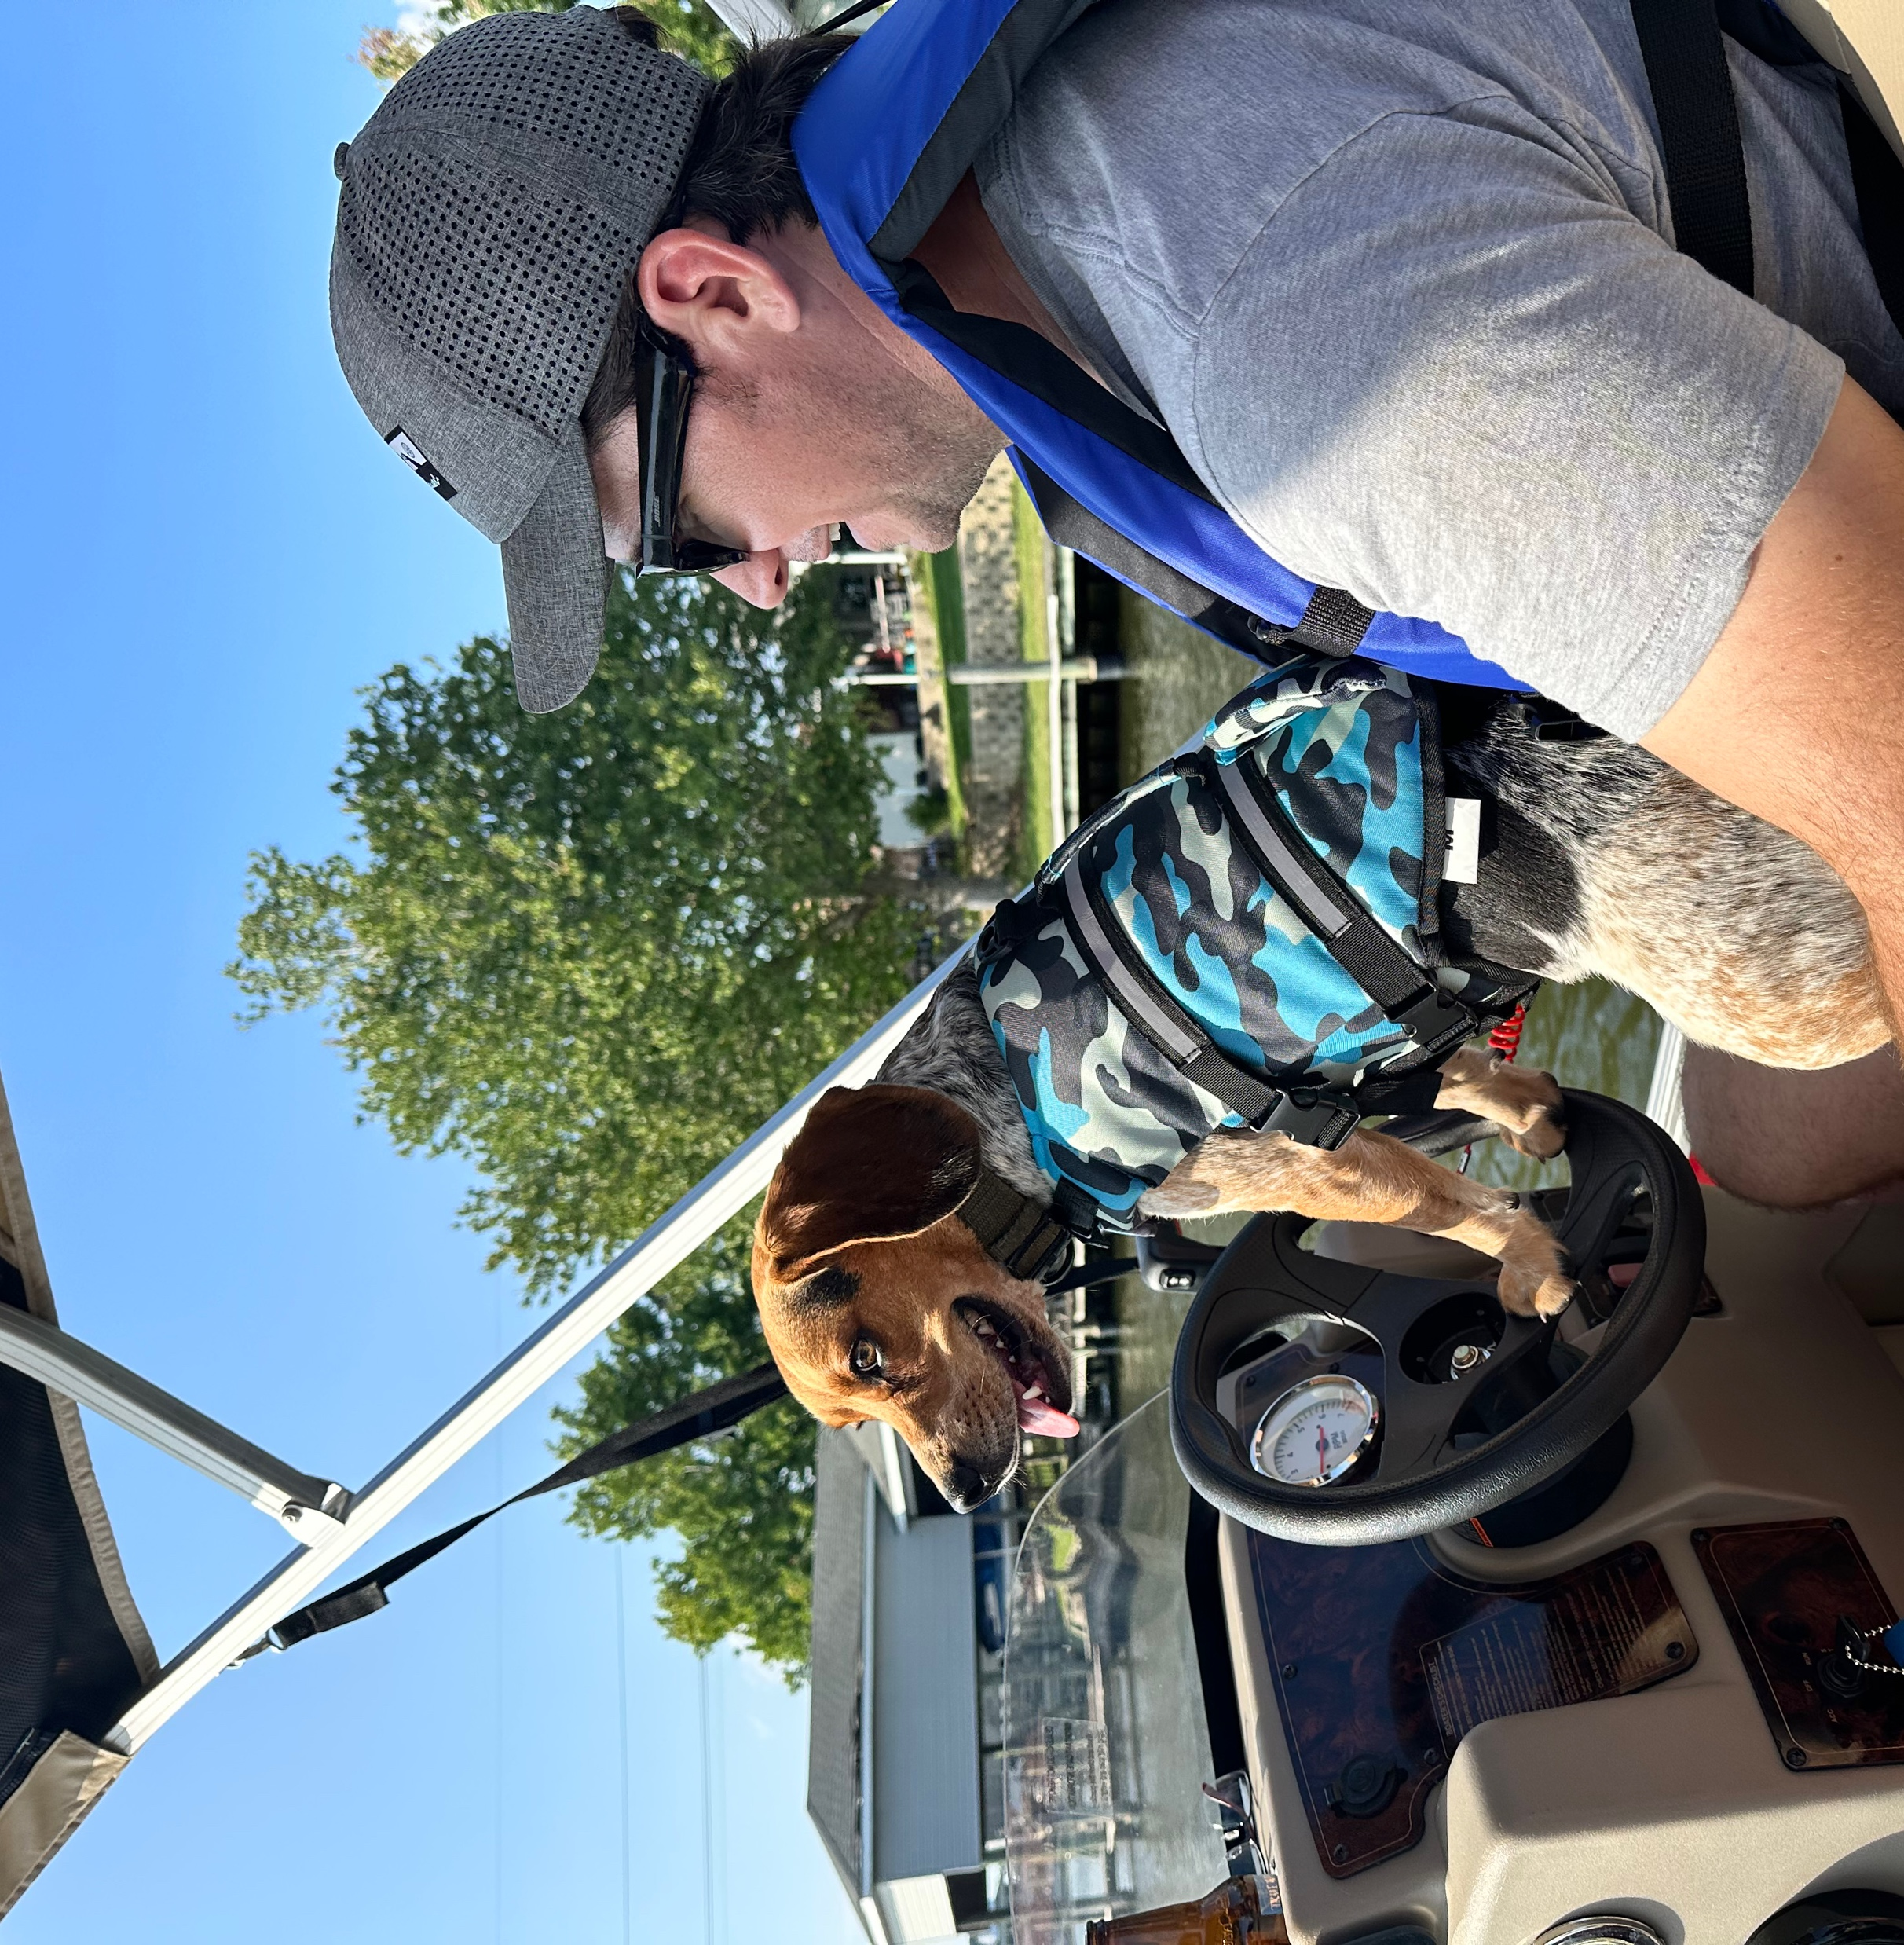
Data Scientist
I tell people I am a statistics professor
They don’t ask you any questions
Data scientist: a term for a person who uses coding to answer questions with data
A big job area!

Slide 8
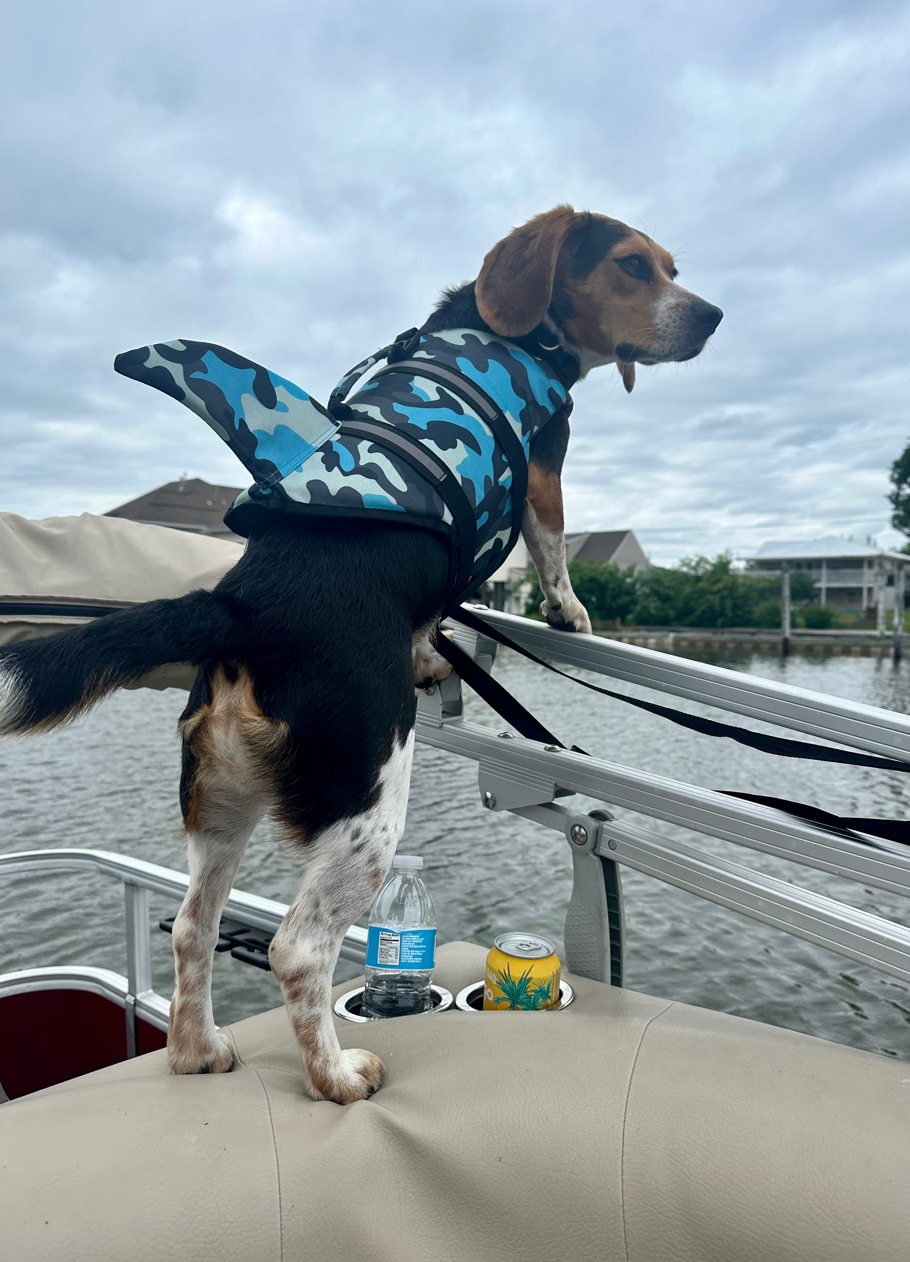
Research
Example research project:
Patients with migraine need help tracking their symptoms and headaches
We built them an app!
We used that data to make recommendations for how they can talk to their doctors (the psychology part).

Slide 9
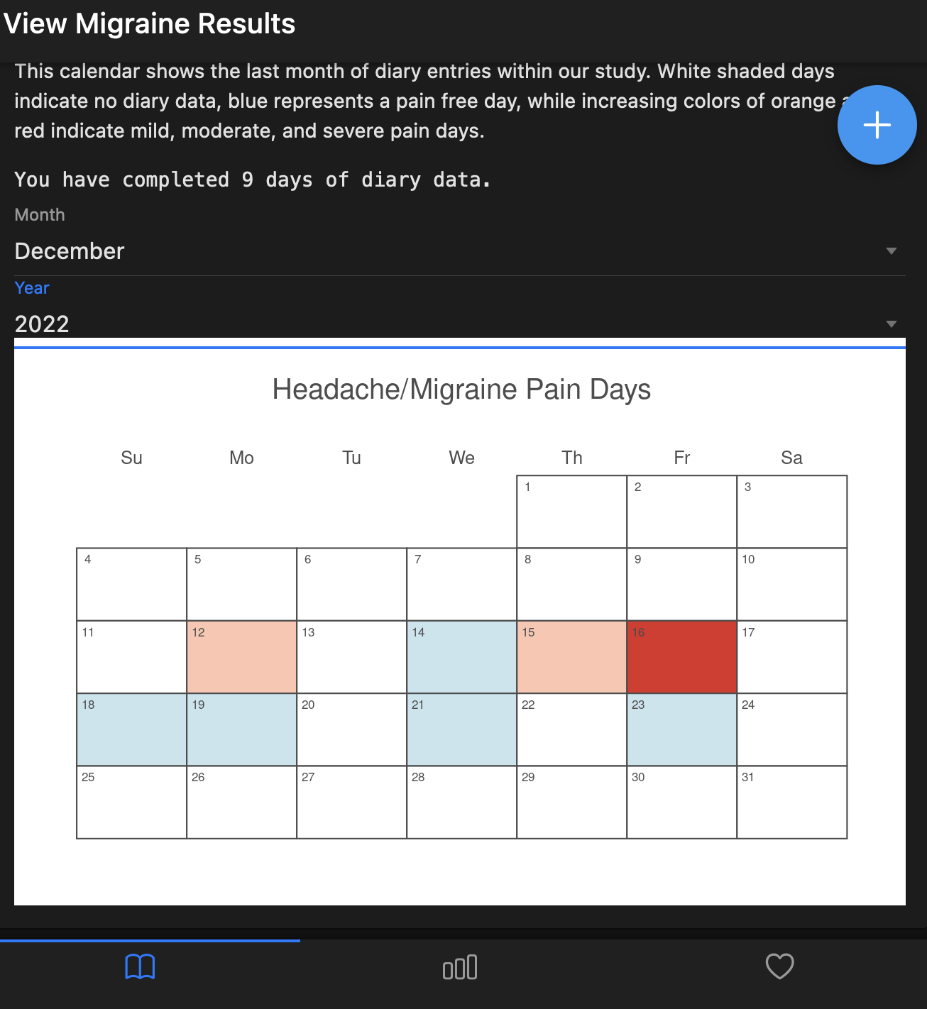
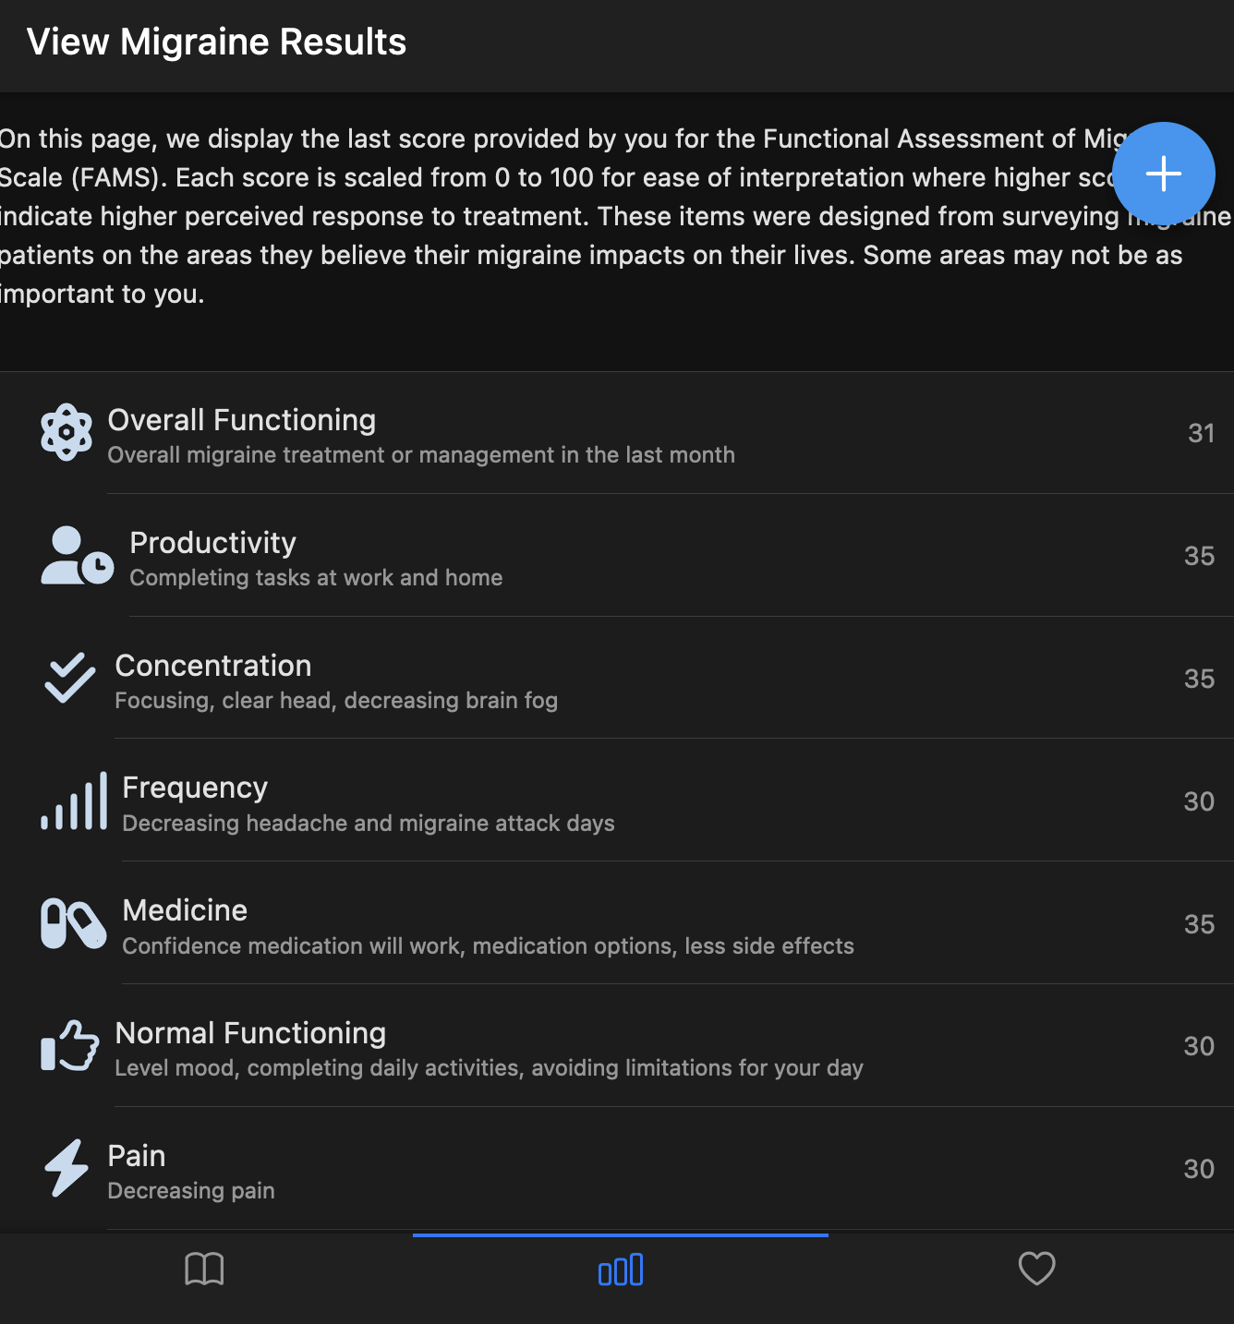

Slide 10
The language Part
Each person’s app shows them their individualized report
Much like targeted ads!
Use natural language processing to figure out what they care about/have issues with
Terms: text analytics, machine learning, artificial intelligence, large language models

Slide 11
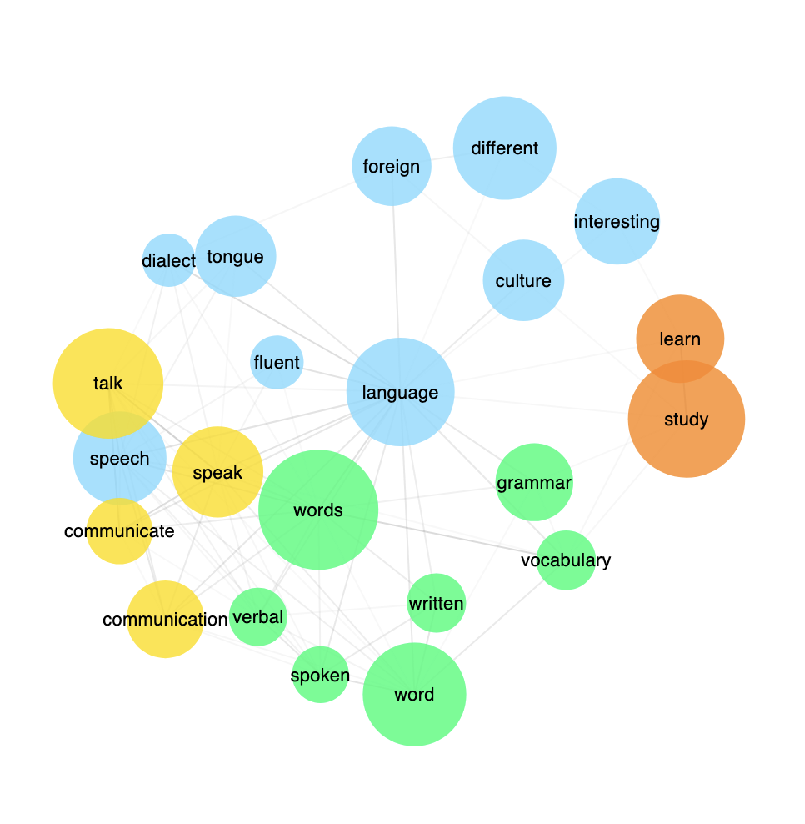

Slide 14
Cheese
Pizza
Cheese
Pizza
Hut
Cheese
Pizza
Hut
Menu

Slide 15
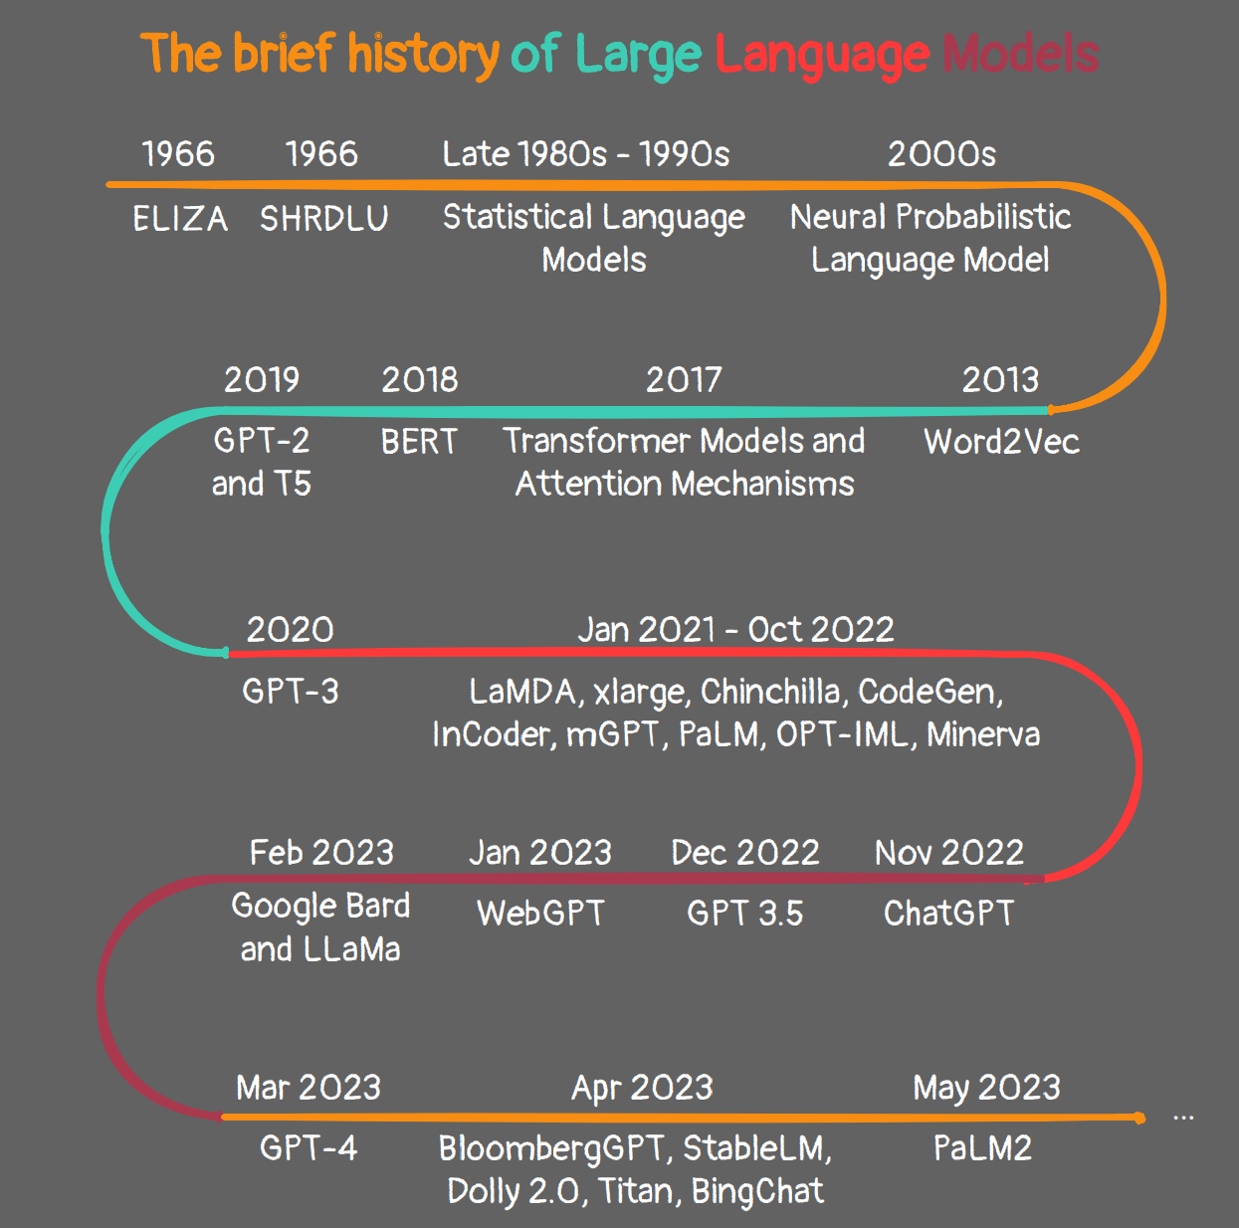

Slide 16
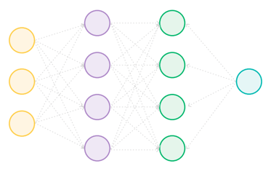
Lots of words
So how do they work?
Lots of word inputs at once
Math!
A lot of math.

Slide 17
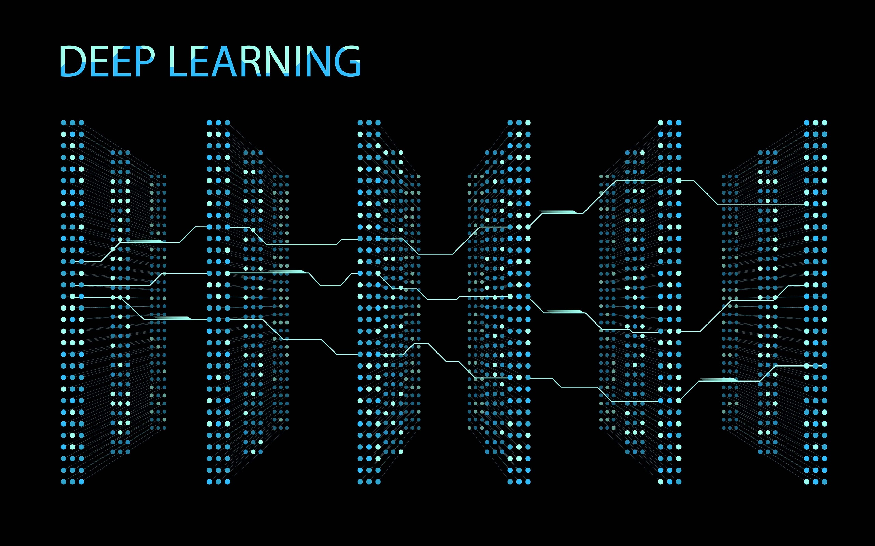
chatGpt
Mention that ChatGPT is an advanced language model designed to understand and generate human-like text based on the input it receives
Natural language is the tricky part!

Slide 18
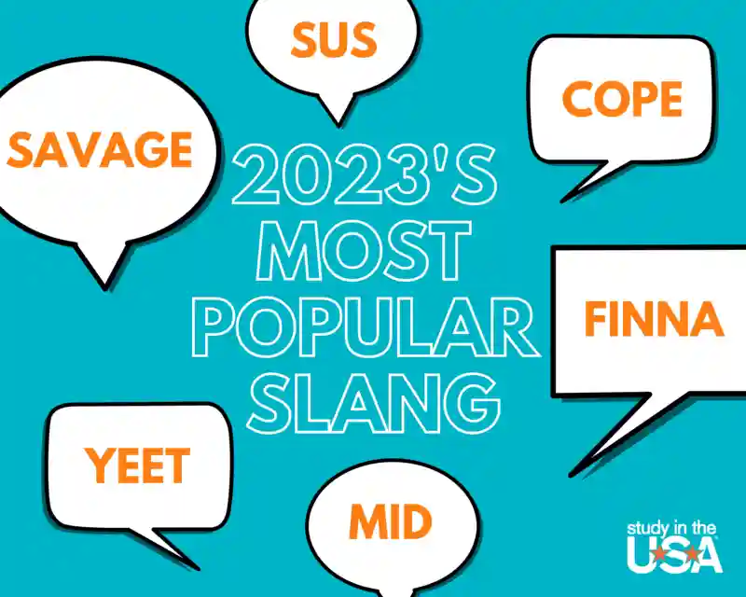
chatGpt
Language from the internet
Model should:
Understand context
Grammar!
The language “small stuff”

Slide 19
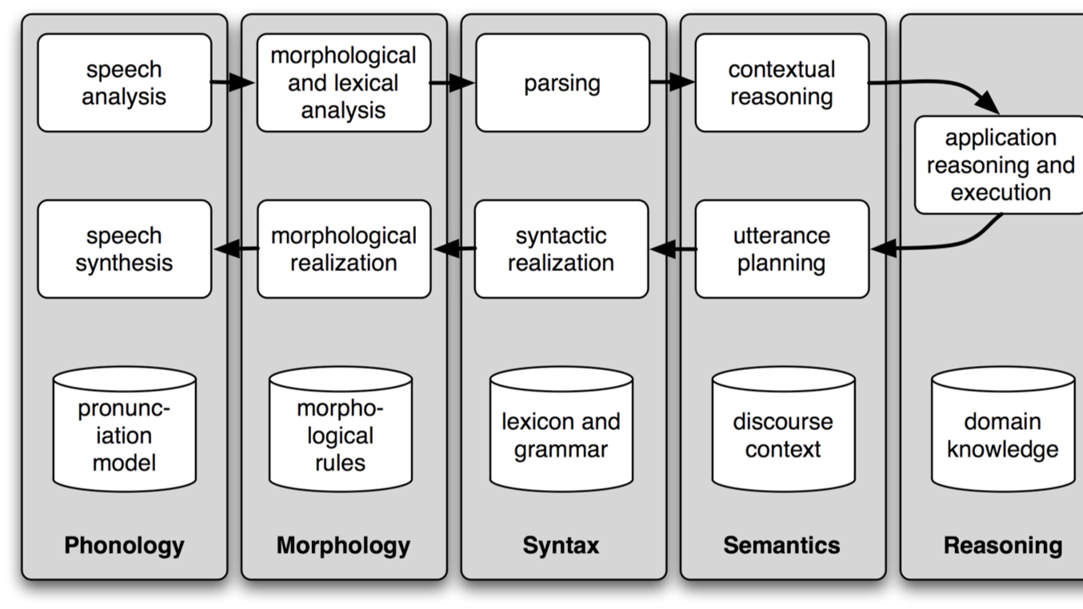

Slide 20
Uses of ChatGpt
Homework help: finding information, explaining concepts, and providing examples for academic subjects.
Creative writing: brainstorming ideas, generating story prompts, or overcoming writer's block.

Slide 21
Uses of ChatGpt
Personal assistant: organizing schedules, setting reminders, and providing recommendations.
General knowledge: answer questions on various topics, making it a valuable resource for learning and exploration.

Slide 23
Ethics
Spread of Misinformation
Lack of Contextual Understanding (it doesn’t know you!)
Inappropriate Content
Dependency on Data Availability
Ethical and Privacy Considerations
Bias in Training Data

Slide 24
If you like books

Slide 26
Gender Bias
What do you think ChatGPT suggested were ways that “girls” could use ChatGPT?
What about “boys”?

Slide 27
Lists for Girls
Language Learning
Personal Interests and Hobbies
Goal Setting and Motivation
Social Issues and Activism

Slide 28
Lists for Girls
Creative Writing Assistance
Fashion and Styling Advice
Pop Culture and Entertainment
Academic Support

Slide 29
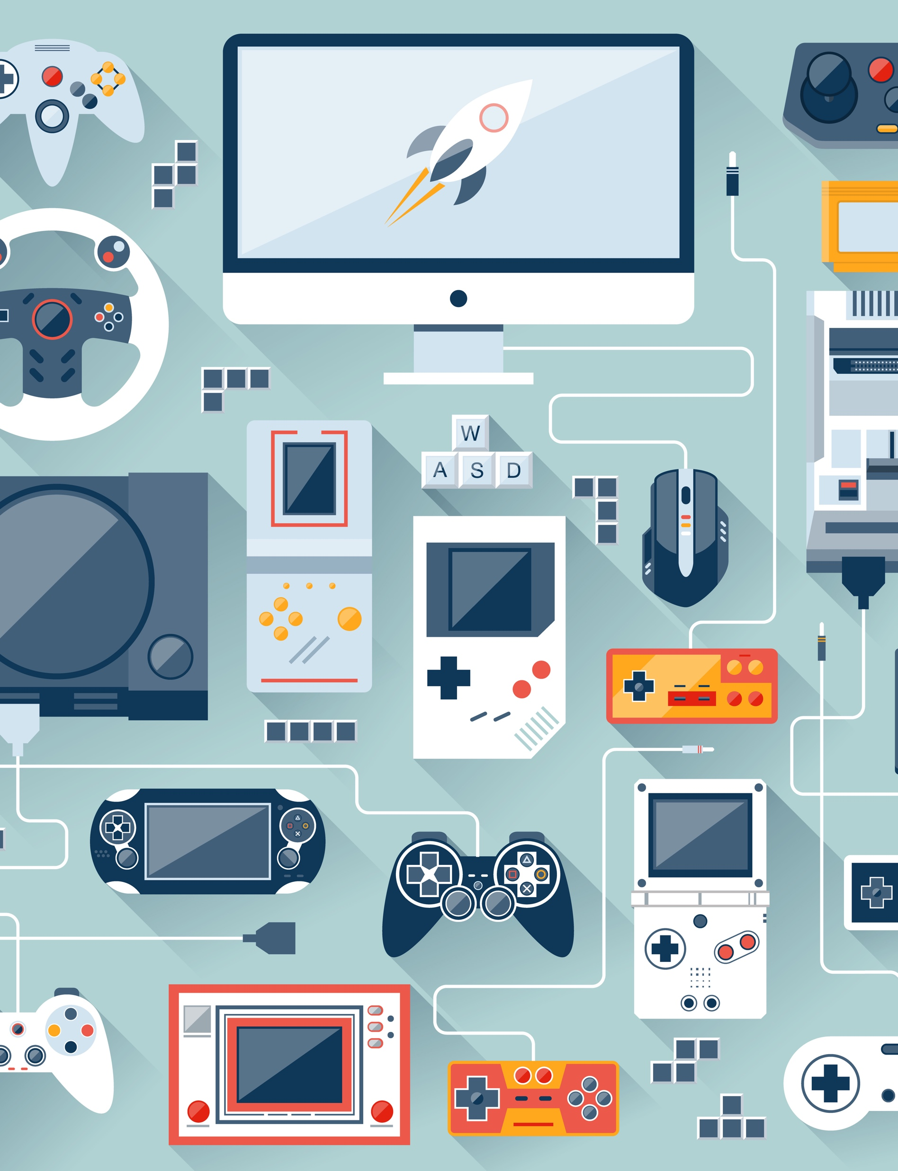
Lists for boys
Gaming Recommendations
Sports and Fantasy Leagues
Technology and Gadgets

Slide 30
Lists for boys
Science Fiction and Fantasy
Sports Analytics and Strategy
Music and Bands
Action Movies and TV Shows

Slide 31
Other bias?

Slide 33
Back to Psychology
Often people think about if they can but not if they should

Slide 35
Where do we go?
Social science + data science = wins
Think about ethics
Public involvement, not just use

Slide 36
Questions

