Slide 1


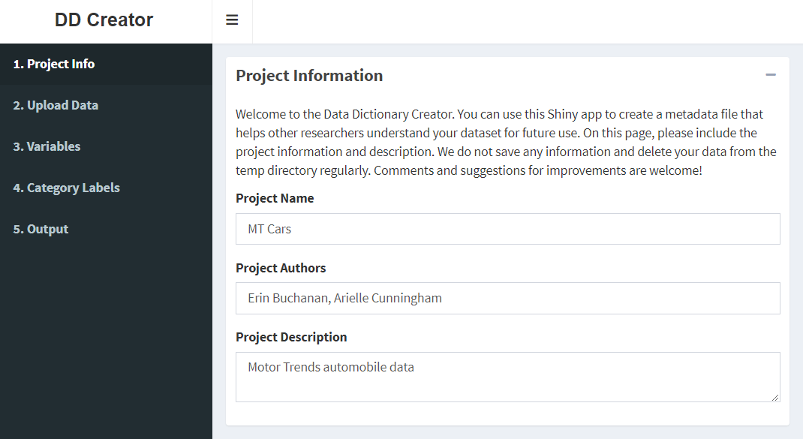
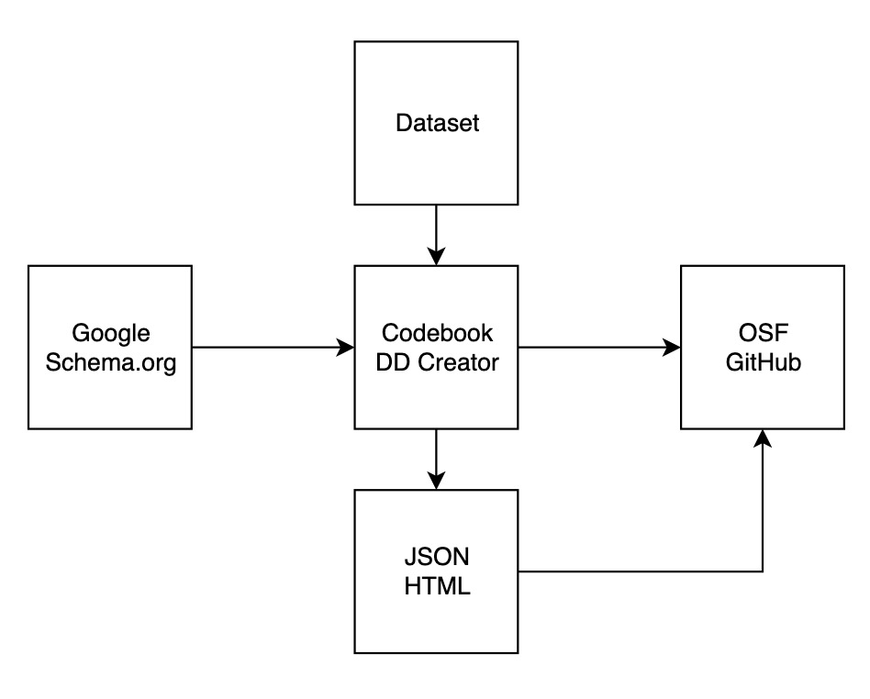
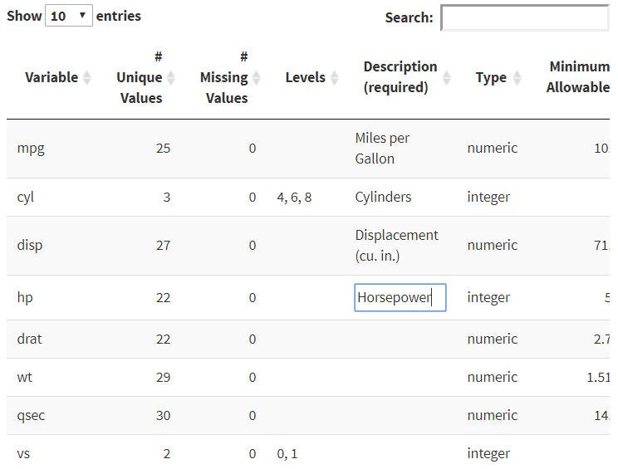
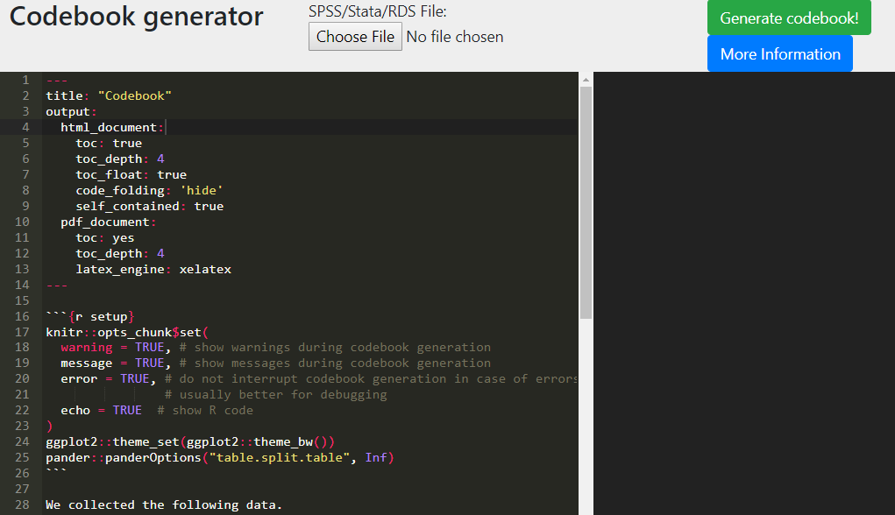
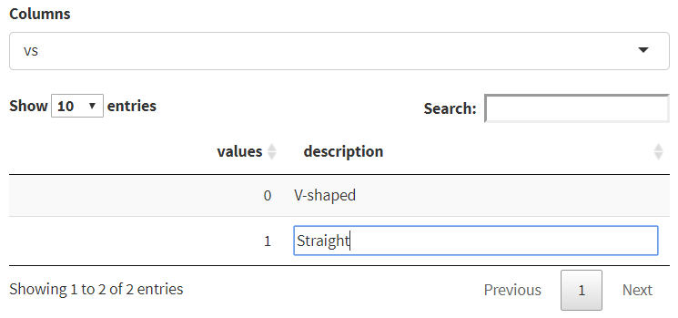
Getting Started Creating Data Dictionaries: Creating Shareable Datasets
Ari L. Cunningham, Sarah E. Crain, Hannah R. Johnson, Hannah Stash, Erin M. Buchanan, PhD
Missouri State University, Harrisburg University of Science and Technology
Summary
Data Dictionary Workflow
DD Creator
What is open science?
A collaborative effort to make the research process more public
Encouragement of transparency throughout all stages of the research process (Nelson, Simmons, & Simonsohn, 2018)¹
Open data discourages fraud and makes replication more likely (Piwowar, 2013) ²
Why data dictionaries?
Data dictionaries are documents that contain metadata about a dataset
They allow researchers to make data more open and easier to interpret
Several dictionary creation apps depending on researchers’ needs
The flowchart below depicts the process of creating a data dictionary. The left side starts with the rules or structure one should follow for creating a machine-readable data dictionary. Next, the dataset is converted to a data dictionary by using an application, like Codebook or DD Creator, that creates the metadata output in JSON, HTML, or another format. Finally, the data dictionary is stored in an online repository, such as the Open Science Framework or GitHub, to share with a larger audience.
 | Codebook | DD Creator
Citation | Arslan (2018) ³ | (DeBruine, Buchanan, & Mohr, 2018) ⁴
Input | CSV, SPSS, Stata, RDS | CSV, Text, Excel, SPSS, SAS
Output | HTML report from Markdown | CSV files of meta-data, JSON, Rdata, HTML report
Benefits | Easiest to use Quick metadata generation Generates a summary for each variable in a readable format | Follows schema.org Specifies a separate section for category labels Rdata output More detailed descriptions, depending on data
DD Creator allows a user to enter metadata for each column provided in the dataset, while automatically providing a starting point for the number of unique values, missing values, variable type (i.e., character, numeric), and minimum/maximum values. A description of each column can be added, along with information about the levels/groups in the data and synonyms for the variables. On a separate page, category labels can be provided for both character and numeric data (i.e., Likert-type scales that include labeled numbers). Users can also enter information about dataset properties such as authors and collection dates, according to schema.org recommendations. This application allows users to create an HTML report, a JSON file formatted to follow guidelines for datasets from schema.org, and CSV files of their metadata.
Why standardization?
Schema.org is a website that provides structure for what can and should be included in metadata. It provides a community-based set of standards for structured data. One benefit of such standardization is the ability to index one’s dataset so that other researchers can easily find it. Google Dataset Search, which is connected to schema.org, allows researchers to index their datasets using metadata and the JSON file format (see below). Visit the site at https://toolbox.google.com/datasetsearch. For psychological research, current standardization efforts include the Psych-DS project (Kline, 2018) ⁵. Data dictionaries are one component of this broader effort.
Codebook
What is JSON?
JSON, which stands for JavaScript Object Notation, is a machine-readable file format used to represent data. Specifically, data is encoded as name/value pairs. The code block on the right shows an example. JSON files can be easily imported, indexed, and shared through sites such as Google Dataset Search.
"creator": [
{
"type": "Person“
"id": 1,
"givenName": "Ari",
"familyName": "Cunningham",
"email": "arielle924@gmail.com",
"affiliation": "Missouri State U"
}]
Screenshots of the data entry for DD Creator, including overall variable and individual level attributes. This app will feel familiar to those who use SPSS.
References
Nelson, L. D., Simmons, J., & Simonsohn, U. (2018). Psychology’s Renaissance. Annual Review of Psychology, 69, 511–534. https://doi.org/10.1146/annurev-psych-122216-011836
Piwowar, H. A., & Vision, T. J. (2013). Data reuse and the open data citation advantage. PeerJ, 1, e175. https://doi.org/10.7717/peerj.175
Arslan, R. C. (2018). How to automatically generate rich codebooks from study metadata. https://doi.org/10.31234/osf.io/5qc6h
DeBruine, L., Buchanan, E. M., & Mohr, A. H. (2018, July 1). ddcreator. Retrieved November 24, 2018, from https://github.com/debruine/ddcreator
Kline, M. (2018). psych-DS. Retrieved from https://github.com/psych-ds/psych-DS
Codebook is an R package with a corresponding website that allows researchers to create reports of their data, including reliabilities and summaries of items (e.g. histograms, descriptive statistics). Of the available options, codebook is the quickest and easiest to implement; however, non-computer-savvy users would have trouble editing the automatically produced output if they wished to add more information.
For more information, please contact Ari Cunningham at: arielle924@live.missouristate.edu
Check out the Open Science Page and research tutorial paper at: https://osf.io/3y2ex/
Check out the DD Creator code at: https://github.com/doomlab/dd-creator
Notes:
Do we still like the title?

