Slide 1
A PSA on the PSA: Big Team Science with the Psychological Science Accelerator

Slide 2
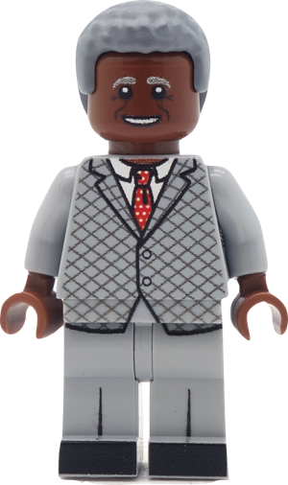
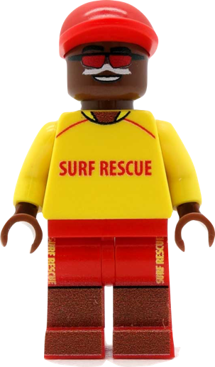
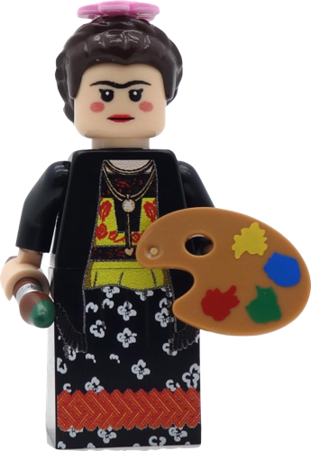
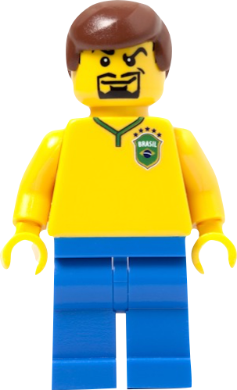
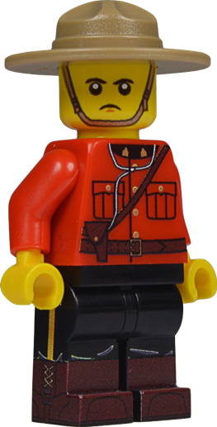
Big Team Science

Slide 3
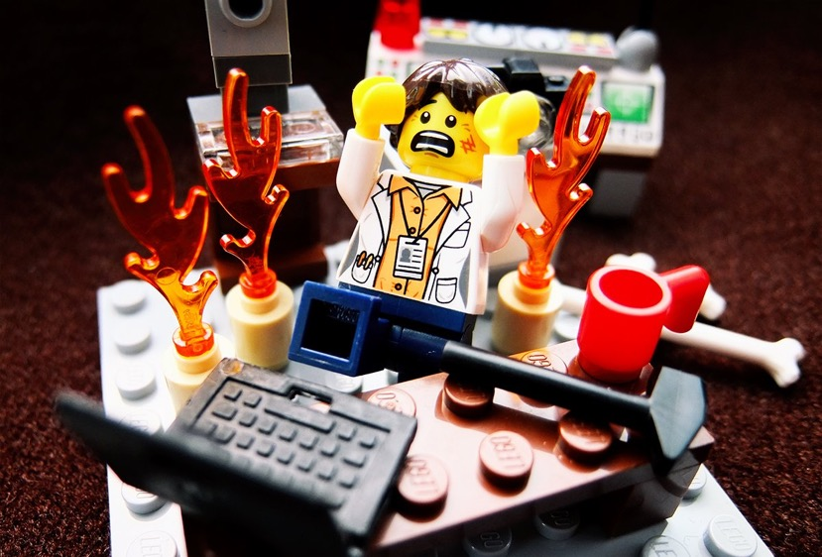
Example Projects
Reproducibility Project: Cancer Biology
Reproducibility Project: Psychology
Many Smiles Project
Many Labs
And more!

Slide 4
Example Teams
Psychological Science Accelerator
ManyBabies Consortium
ManyPrimates project
Collaborative Replication and Education Project

Slide 5
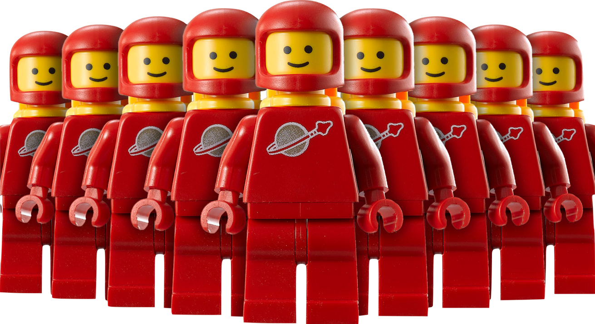
Replication
Notes:
https://gizmodo.com//everything-you-always-wanted-to-know-about-lego

Slide 6
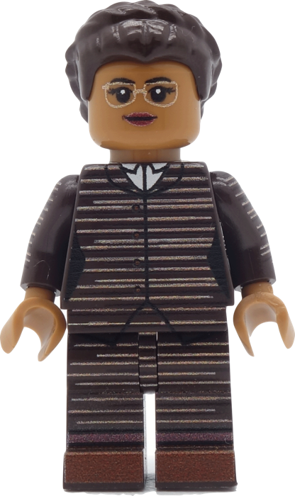
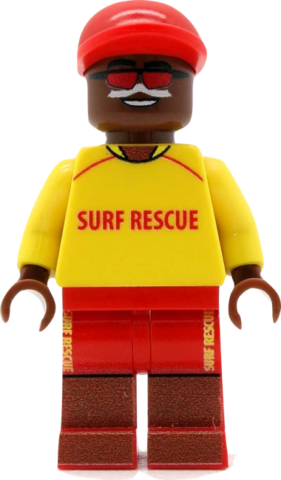
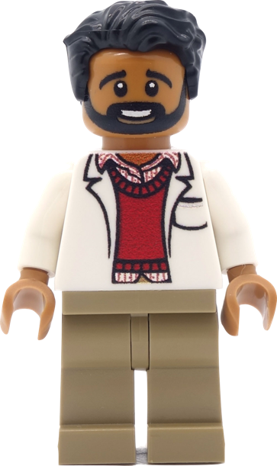
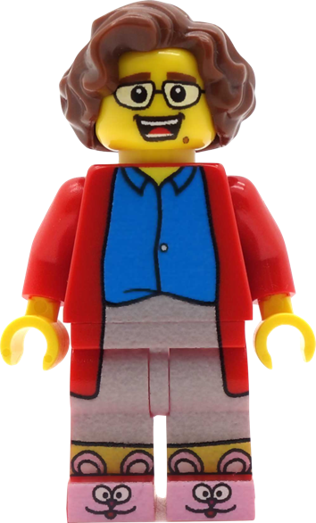
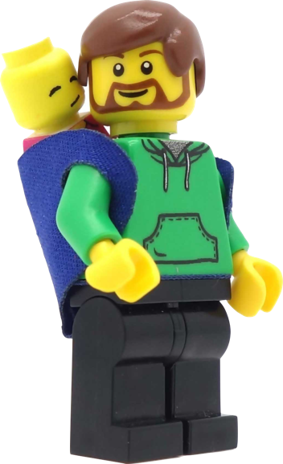
Generalizability

Slide 7
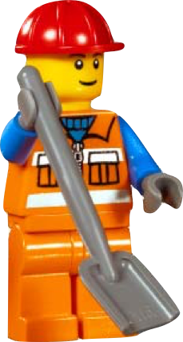
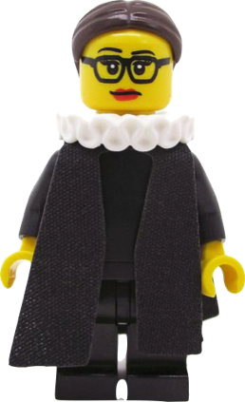
W.I.E.R.D. Science
Notes:
Western, Educated, Industrialised, Rich, Democratic

Slide 9
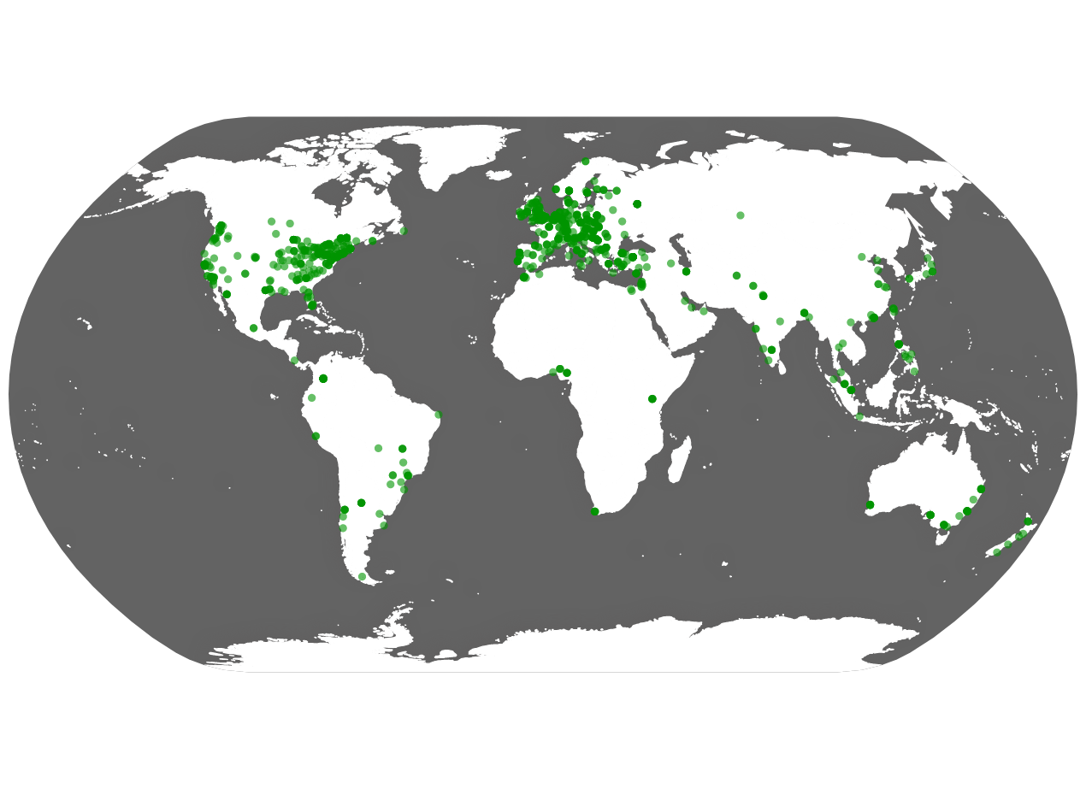

Slide 10
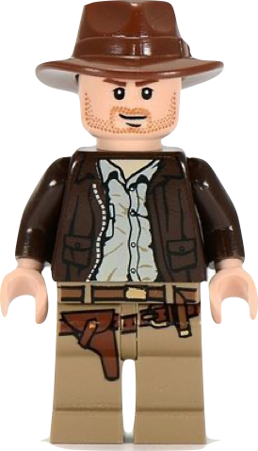
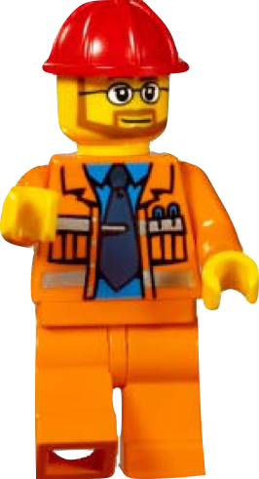
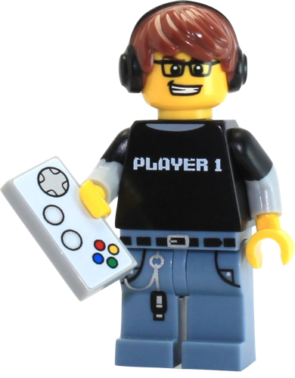
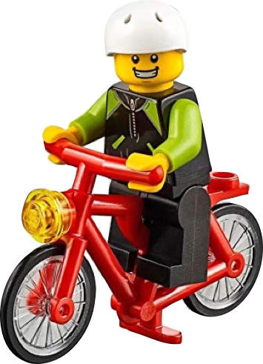
Psychological Science Accelerator
Director
Associate
Directors
Assistant
Directors
Members
Interns

Slide 11
Psychological Science Accelerator
Leadership Team
Training
Funding
Study Selection
Community Building & Network Expansion
Project Management
Ethics
Translation & Cultural Diversity
Data & Methods

Slide 12
PSA Process
Submission and Evaluation
Feasibility Review, Identify Reviewers
Submission Review
Preparation
Finalize Protocol
Establish Collaboration Agreement
Make Final Decisions
Translation and Ethics

Slide 13
PSA Process
Implementation
Pre-registration
Data Collection
Data Management
Analysis and Dissemination
Confirmatory Analyses + Exploratory Analyses
Manuscript Submission

Slide 14
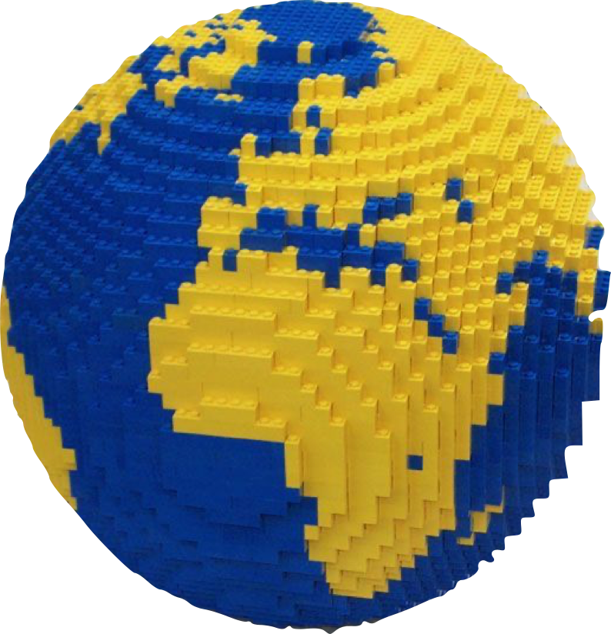
Social Perception of Faces Around the World
Ben Jones & Lisa DeBruine (University of Glasgow, Scotland)
Published in Nature Human Behaviour
To which world regions does the valence–dominance model of social perception apply?
PSA001

Slide 15
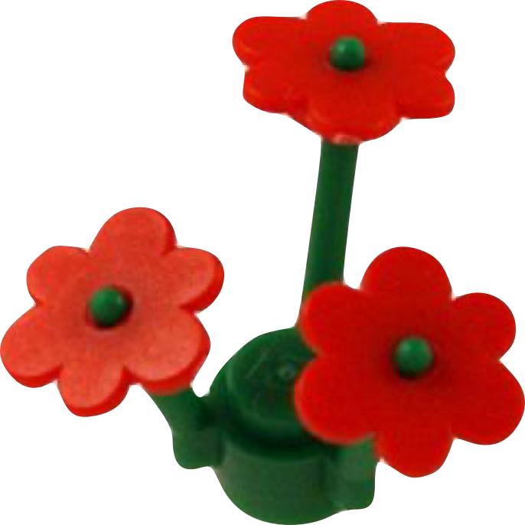
Object Orientation
Sau-Chin Chen (Tzu-Chi University, Taiwan)
IPA Psychonomic Bulletin & Review
Does the match advantage for object orientation replicate and extend beyond English?
PSA002
Notes:
PSA002: Sau-Chin Chen, Tzu-Chi U, Taiwan
Mental simulation theories of language comprehension propose that people automatically create mental representations of real objects. Evidence from sentence-picture verification tasks has shown that people mentally represent various visual properties such as shape, color, and size. However, the evidence for mental simulations of object orientation is limited. We report a study that investigates the match advantage of object orientation across speakers of different languages.

Slide 16
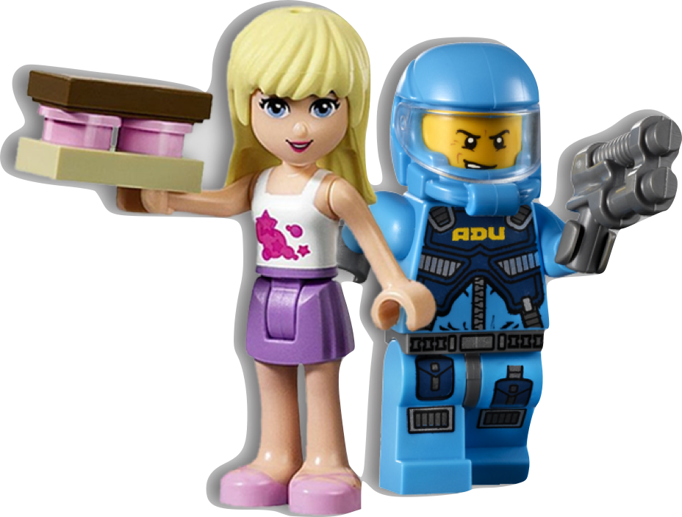
Gendered Prejudice
Curtis Phills (University of North Florida, USA)
Writing
What is the gendered nature of prejudice across social categories?
PSA003
Notes:
The present research will describe the gendered nature of prejudice against seven social categories (i.e., Black people, East Asian people, White people, police, politicians, and criminals). We hypothesize that if a prejudice occurs for the group it is more strongly related to prejudice of the men of that social category.

Slide 17
True Belief
Braeden Hall (Southern Illinois University, USA)
Jordan Wagge (Avila University, USA)
Accelerated CREP - IPA AMPPS
Does the justified true belief effect replicate?
PSA004
Notes:
Advances in Methods and Practices in Psychological Science
A multisite Collaboration preregistered replication of Turri and colleague’s (2015) Experiment 1 (35 labs from 14 countries across 4 continents signed up at time of submission; expected minimum N = 1,500). Results of this study are expected to provide a clearer picture of the Gettier intuition effect size, lay people’s theory and practice of knowledge, and potentially cross-cultural similarities and differences.
The Collaborative Replications and Education Project (CREP) is a crowdsourced replication project for undergraduate researchers started by Jon Grahe and Mark Brandt and currently run by Jordan Wagge. Studies are available that are both highly cited and feasible for undergraduates to complete. Contributors who meet open science reporting guidelines receive a CREP Research Certificate and when there are enough samples, contributors are encouraged to collaborate on a research paper.

Slide 18
Stereotype Threat
Patrick Forscher (Busara Centre, Nairobi)
Valerie Jones Taylor (LeHigh University, USA)
Neil Lewis Jr (Cornell, USA)
Daniel Cavagnaro (Fullerton, USA)
IPA Nature Human Behaviour
What is the best way to induce stereotype threat?
PSA005
Notes:
US-based labs to recruit a large sample of African American students to participate in a test of stereotype threat theory. They are using an adaptive design to determine the best of four procedures each to increase and reduce stereotype threat.

Slide 19
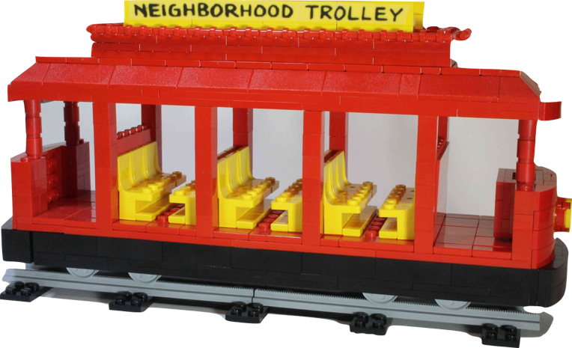
Trolley Problem
Bence Bagó (IAT, Toulouse, France)
Balas Aczel (Eötvös Loránd University, Hungary)
Published in Nature Human Behaviour
Does the trolley problem replicate?
PSA006
Notes:
Empirically test the universality of utilitarian and deontological responding by directly replicating Greene et al.’s experiments on non-WEIRD samples as well as to explore the influence of culture and economic status on moral reasoning.

Slide 20
SPAM-L
Erin Buchanan
(Harrisburg University of Science & Technology, USA)
R&R at Nature Human Behaviour
Can we find semantic priming across languages?
PSA007
Notes:
PSA007: Erin Buchanan (Harrisburg U of Sci & Tech, Pennsylvania)
semantic priming relies on reliable, well-studied stimuli with defined similarity values.
Create an online framework to collect semantic priming data
Provide a database of response latencies and priming scores for words in 5-9 of the 9 languages with available frequency data

Slide 21
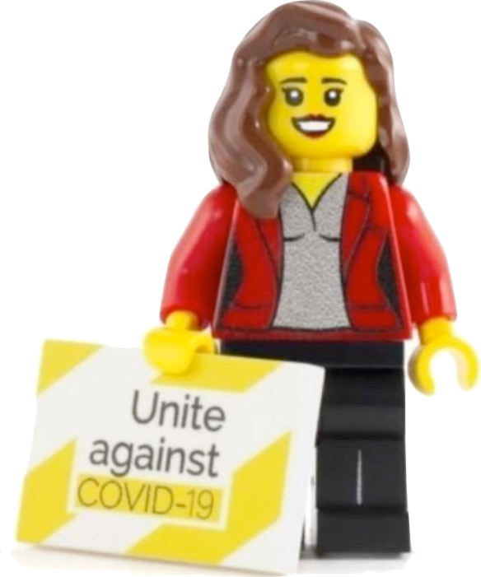
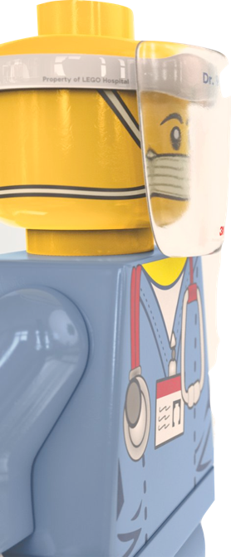
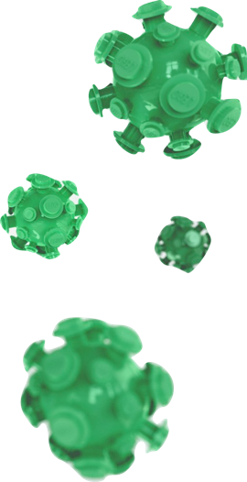
CR001: Loss Gain
Affective Science (R&R)
CR002: Cognitive Reappraisal
Nature Human Behaviour
CR003: Self Determination
PNAS
COVID Projects
And some data too!
Notes:
001 Loss/Gain - Charles Dorison Kellog Northwestern
test competing hypotheses regarding the effects of framing messages in terms of losses versus gains. We will examine effects on three primary outcomes: intentions to adhere to policies designed to prevent the spread of COVID-19, opinions about such policies, and the likelihood that participants seek additional policy information. Whereas research on negativity bias and loss aversion predicts that loss-framing will have greater impact, research on encouraging the adoption of protective health behaviour suggests the opposite (i.e., gain-framing will be more persuasive).
002 Cognitive reappraisal - Ke Wang, Harvard
Randomly assign participants to one of three reappraisal interventions (reconstrual, repurposing, and their hybrid) or a control condition. We predict that relative to the control condition, reappraisal will reduce immediate and anticipated negative emotions, increase immediate and anticipated positive emotions, and enhance emotion regulation self-efficacy. Importantly, we expect reappraisal to reduce intentions to engage in emotion-driven problematic behaviors (e.g., substance use) without reducing intentions to engage in healthy behaviors
003 Self Determination - Nicole Legate, Illinois IT & Thuy-vy Nguyen, Durham
Tests whether self-determination theory-guided message framing impacts people’s motivation to participate in social distancing. They expect autonomy-supportive messages that help people understand the value of behavior change to a) increase ‘buy in’, or autonomous motivation, for social distancing, b) lower feelings of defiance to follow recommendations around social distancing, and c) increase feelings of self-efficacy to participate in social distancing, relative to neutral and controlling messages. Further, we expect controlling messages that pressure people to change using shame, guilt, and threats, may backfire and a) decrease ‘buy in’ for social distancing and b) increase defiance, relative to the control condition.
Left image by Nico Martinez https://forum.keyshot.com/index.php?topic=26067.0&utm_content=126967006&utm_medium=social&utm_source=twitter&hss_channel=tw-178092400

Slide 22
Study | Nickname | Status | Authors | Langs | Countries | N
PSA001 | Social Faces | published | 243 | 25 | 44 | 12660
PSA002 | Object Orientation | RR2 revisions | 115+ | 18 | 18 | 3743
PSA003 | Gendered Prejudice | data analysis | 115+ | 18 | 18 | 3500+
PSA004 | True Belief | RR2 in prep | 135+ | 12 | 19 | 9275*
PSA005 | Stereotype Threat | data collection | 44+ | 1 | 1 | ~700
PSA006 | Trolley Problem | published | 155 | 27 | 45 | 27502
PSA007 | SPAM-L | RR1 R&R | 100+ | 40+
CR001 | Loss Gain | R&R | 455 | 42 | 87 | ~27K
CR002 | Cognitive Reappraisal | published | 455 | 42 | 87 | 27989
CR003 | Self Determination | published | 483 | 42 | 89 | 25718

Slide 23
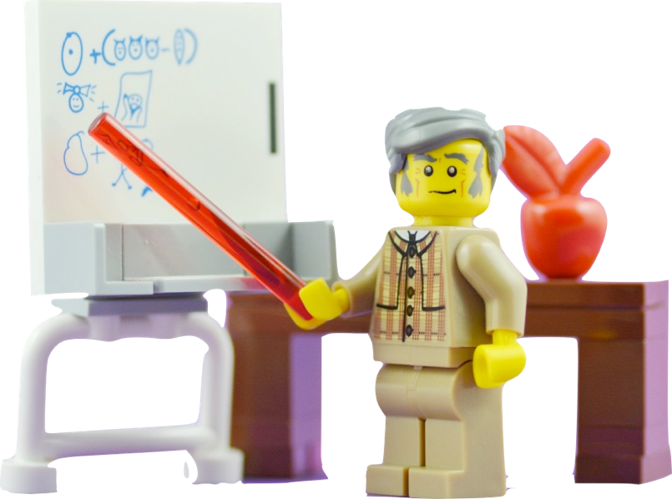
Growing Pains – Project Management
No one was trained for this!
How do you manage so many people?
Tracking students after they graduate
IRBs across the globe
Translation

Slide 24
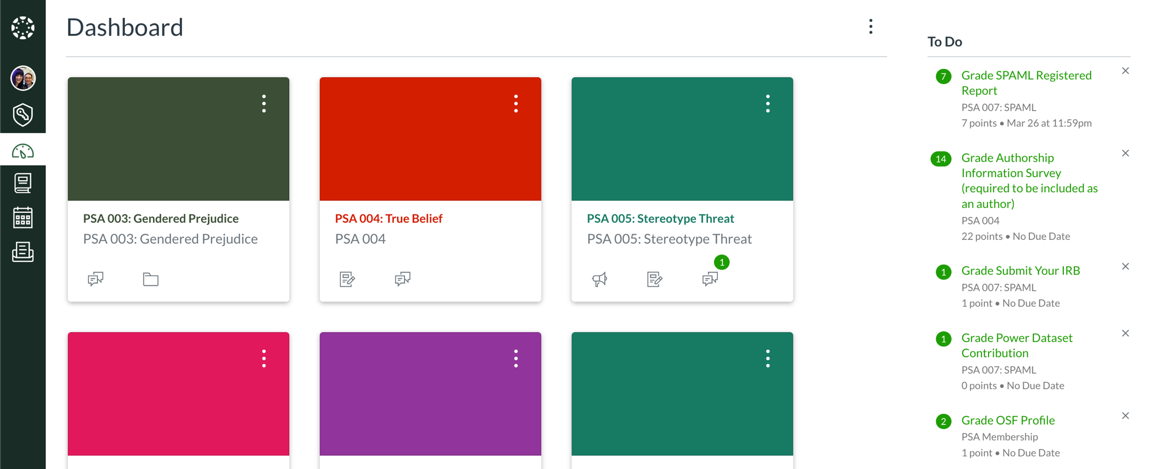

Slide 25
Growing Pains - CRediT
Contributor Roles Taxonomy
Not everyone can collect data
Incentivize other contributions (code review, management, programming)
Diversifying the people who do the things
Not all geopolitical regions work well together

Slide 26
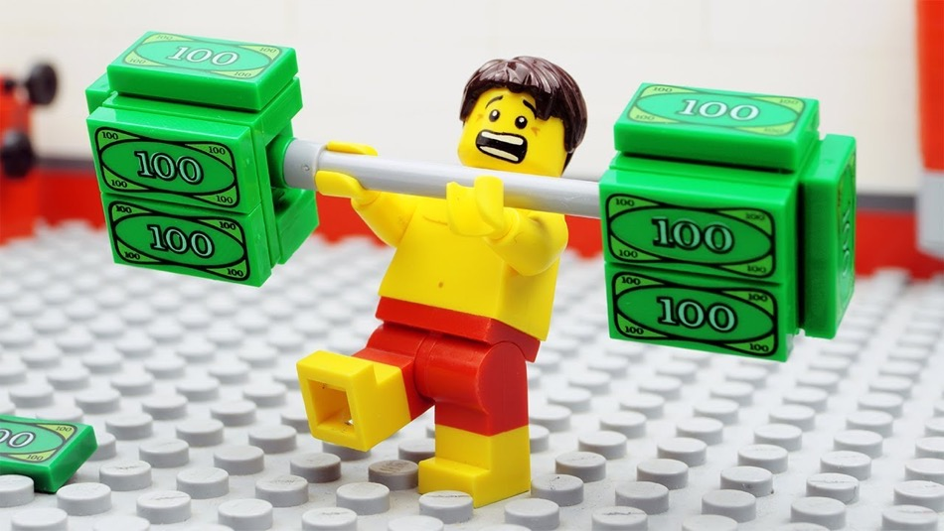
Growing Pains - Funding
Funding projects is terribly difficult
Funding infrastructure is even worse!
Comparison to the Open Science Framework

Slide 27
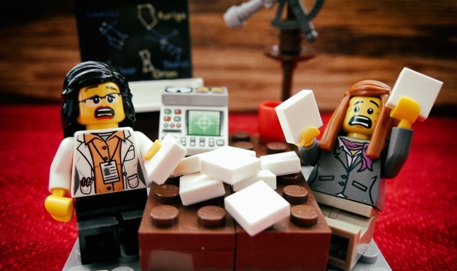
Growing Pains - Implementation
Consider some of the following:
Not everyone has access to paid software and tools (Qualtrics, Survey Monkey, SPSS)
Not all countries have open access to the internet (Google, Qualtrics)
Each lab may not have the skill set to run the study
Ensuring equality of methods between labs can be difficult
Combining datasets is a nightmare
Learning a new toolset for each study can be daunting

Slide 28
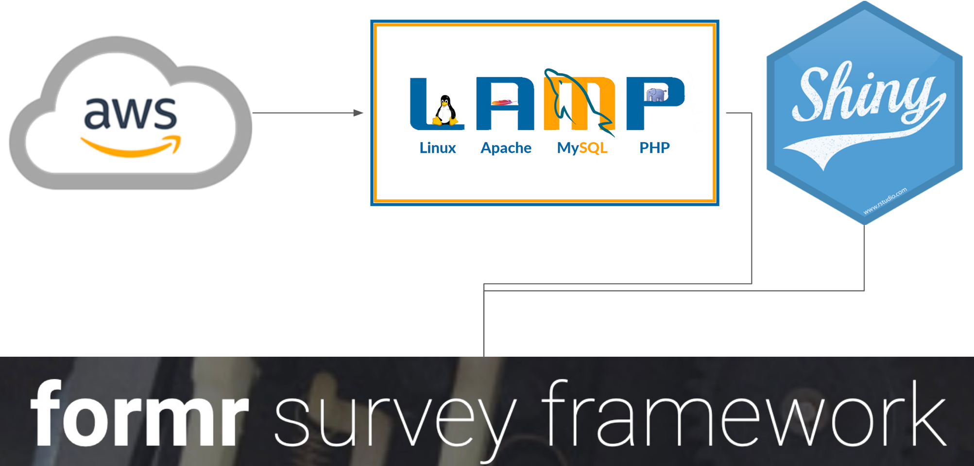

Slide 29
Growing Pains – Journals
Journals are not ready for Big Team Science
Page limits, authorship rules, and bad manuscript submission systems
Consortium authorships are not favored

Slide 30
Summary
Big Team Science is on the rise in the social sciences
Groups collaborate on best practices
A catch-22: as we get better at this, we expect more from teams
Good science is worth the trouble!

Slide 31
Thanks to Lisa DeBruine for the Lego Slides

